Slide 1
2024 Annual Membership Meeting
State of the Fund
March 6, 2024
Hyatt Lost Pines Resort
Cedar Creek, Tx

Slide 2
A Brief History of The Fund
Insurance committee formed through TWCA in 1987 to explore options
Operations began in 1988
32 Initial Members
$1 Million in Annual Contributions
Limited Services – More focused on start-up operations – people, systems, reinsurance, standard processes, etc.

Slide 3
Current State of the Fund
90 + Members—all members retained as of the July 1st renewal
$10.0 Million in Annual Contributions
Full Compliment of Services including:
  Program Management
  Investment Management
  Leadership Training and Development
  Safety and Loss Control Training
  Risk Management Consultation
  Cyber Security
  Legal Consultation

Slide 4
Changes in the Fund Board
Jace Houston Moves On
  Served on Board from 2008 to 2023
  Served as Chair of Fund at departure
Kathy Turner-Jones – PGCD; elected as Chair
Sonny Hinojosa – HCID No. 2; elected as Vice Chair
Pam Steiger – SJRA; Board appointment to fill Jace Houston’s place on the Board

Slide 5
Changes in the Fund Board
Norman Ashton Retires
  Served on Board from 2007 to 2023
  Direct Risk Management Experience
Mick Maguire – TRWD; Board appointment to fill Norman Ashton’s place on the Board

Slide 6
Current Board of Trustees
Kathy Turner Jones, Chair, Prairielands Groundwater Conservation District
Sonny Hinojosa, Vice Chair, Hidalgo County Irrigation District #2
Derek Boese, Trustee, San Antonio River Authority
Liz Fazio Hale, Trustee, Gulf Coast Authority
Sonia Lambert, Trustee, Cameron County ID #2 and Cameron County DD #3
Mick Maguire, Trustee, Tarrant Regional Water District

Slide 7
Current Board of Trustees
Jeffrey Mayfield, Trustee, North Texas Municipal Water District
David Montagne, Trustee, Sabine River Authority of Texas
Pam Steiger, Chair, San Jacinto River Authority
Jonathan Stinson, Trustee, Guadalupe-Blanco River Authority
John Womack, Trustee, Colorado River Municipal Water District
Stacey Steinbach, Fund Secretary, Texas Water Conservation Association, (Non-Board Member Officer)

Slide 8
2023 ACCOMPLISHMENTS
Performance Audit Report
  Performance audit reviews all services provided by the Fund Administrator (contract, policies and industry best practices)
  Key component of the Board’s due diligence in selecting its Fund Administrator
  Report delivered at March 2023 meeting
  Report Findings Most Favorable – Above average services; below market pricing

Slide 9
2023 ACCOMPLISHMENTS
Claims Audit Also Conducted
  Detailed review of claims handling and claims management
  Review based on Fund’s claims handling standards and industry best practices
  Claims Audit performed every three years
  Another component of the Board’s due diligence
  Report delivered at March 2023 meeting –
  Findings complementary of Fund’s Claims Handling

Slide 10
2023 ACCOMPLISHMENTS
Shifted to Financial Audit Work by Johnson Lambert
Unqualified Opinion on the 2022-2023 Financial Audit
GFOA ACFR recognition for prior years financial report – continuously since 1993
Implemented Annual Financial Stress Testing

Slide 11
2023 ACCOMPLISHMENTS
?New Members? joins the Fund
Rate Stabilization
  Board approved anticipated use of $1.1 million in surplus to help reduce the impact of rate increases (for renewals effective July 1, 2023)
  Reduces member contributions

Slide 12
CURRENT STATE OF THE FUND
FINANCIAL PERFORMANCE
FINANCIAL PERFORMANCE

Slide 13
FINANCIAL PERFORMANCE
2022-23 AUDITED COMPARED TO 2021-22 AUDITED (as of 6/30/23)
ASSETS
LIABILITIES
NET POSITION
$39.9M
$7.6M
$22.3M
Decrease of
$300k
Decrease of $1.4M
Increase of
$1.1M
CONTRIBUTIONS
CLAIM EXPENSES
INVESTMENTS
$10.9M
$3.0M
$3.7M
$900k
Increase
$1.3M
Increase
Unrealized investment gains up $3.6M

Slide 14
NET POSITION

Slide 15
Investment Income & Gains/Losses

Slide 16
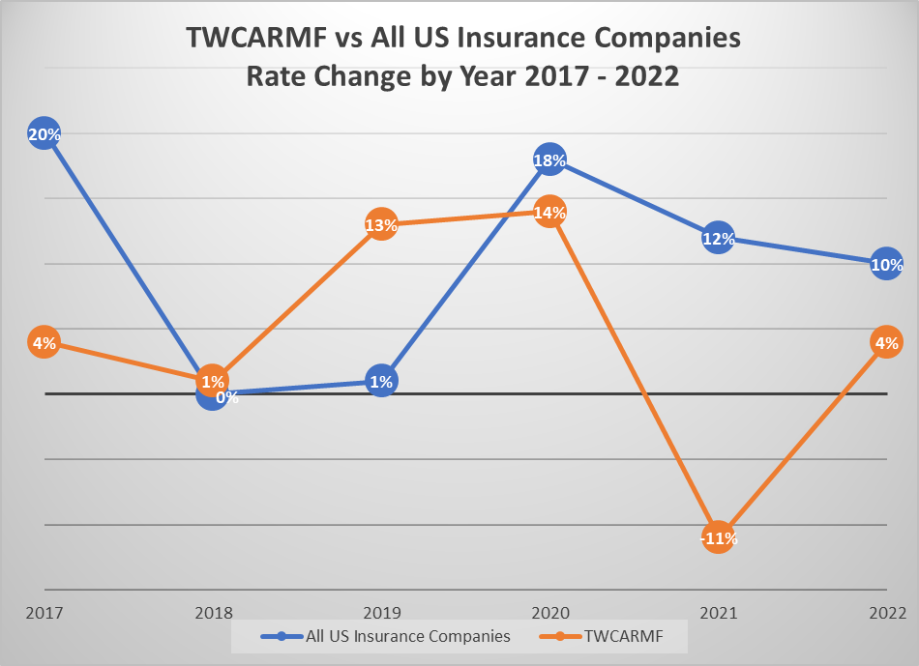
Fund Rate vs Market Rates

Slide 17
CURRENT STATE OF THE FUND
CLAIMS PERFORMANCE

Slide 18
Claim Count by Program (as of 12/31/23)

Slide 19
Claim Cost by Program (as of 12/31/23)

Slide 20
CURRENT STATE OF THE FUND
RISK CONTROL
SERVICE HIGHLIGHTS

Slide 21
RISK CONTROL SERVICES
SURVEYS & CONSULTATIONS and SAFETY-RELATED TRAINING (Jeremy Wade + Joe & Hunter)
RISK MANAGEMENT CONSULTING (Richard Wigzell)
CYBER RISK CONTROL (Lee Cain)
LEGAL CONSULTATION (Joel Geary)
LEADERSHIP TRAINING (Dan Hernandez + Cat & Charita)

Slide 22
Number of Leadership Sessions
Notes:
From 11 sessions in

Slide 23
Staff and Leaders Served

Slide 24
CURRENT STATE OF THE FUND
2023 Safety Award Winners

Slide 25

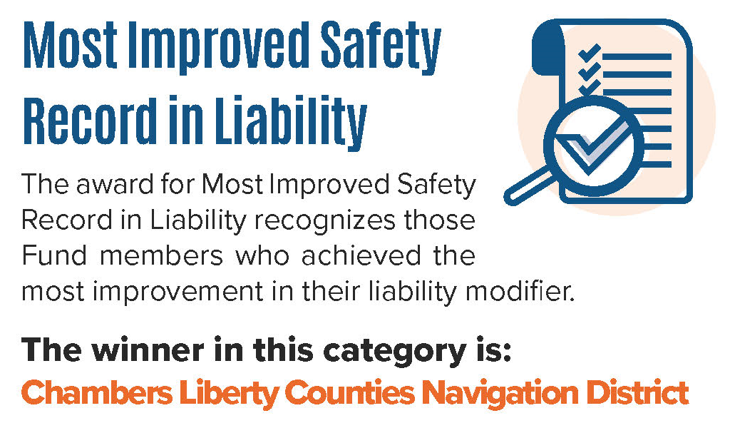
2023 Safety Award Winners

Slide 26

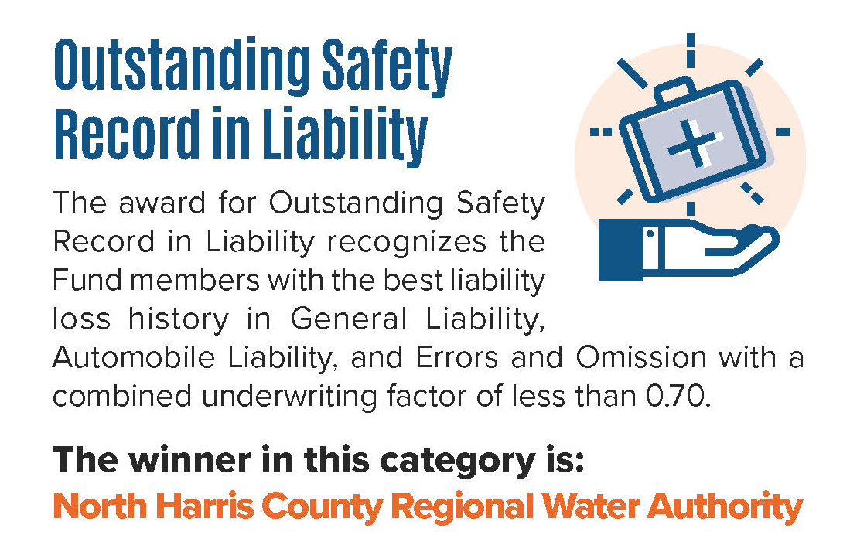
2023 Safety Award Winners

Slide 27

2023 Safety Award Winners
Leroy Goodson Excellence in Risk Management Award
The Fund’s most prestigious award, the Leroy Goodson Excellence in Risk Management Award is awarded to:
SAN JACINTO RIVER AUTHORITY

Slide 28
LOOKING FORWARD
2024-2026 Strategic Plan Implementation & Execution
Tracking Member Utilization of Services
Promote and Increase Utilization of:
  Legal Consulting Services
  Cyber Risk Control
  Leadership Training
  Risk Management Consulting
Targeted marketing efforts for specific prospects to join and strengthen the Fund

Slide 29
CONTACT US – twcarmf.org
FOR MORE INFORMATION CONTACT:
    Greg Womack, Program Executive
    greg.womack@sedgwick.com
    512-427-2309
    Diane Ilenstine, Director Pool Administration
    diane.ilenstine@sedgwick.com
    512-427-2310
    Timm Johnson, Member Services Manager
    timm.johnson@sedgwick.com
    512-427-2312

Slide 30
STUFF HOLDER
4
High Performance
Characteristics
HEX: #005295
Century Gothic - Title
HEX: #5F6062
Calibri (Body) – Main Font
HEX: #E36F1E
HEX: #70CDE3
12
1
2
3
4
5
6
Here’s a short call out to bring attention to something important

